Slide 1
Challenges and opportunities associated with cervical cancer screening programs in a low income, high HIV prevalence context
Amanda Pierz, MSc & Adebola Adedimeji, PhD, MBA

Slide 2
Background
90% of cervical cancer deaths occurred among women in low and middle-income countries (LMICs)¹
Cervical cancer morbidity and mortality in LMICs is mostly preventable¹
The WHO recommends cost-saving options for women living in LMICs, including self-collection of cervicovaginal samples

Slide 3
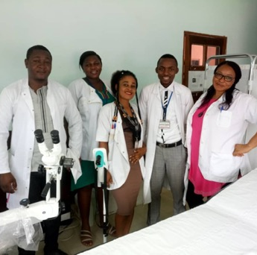
The Context in Cameroon
In 2018, 2,356 new cases of cervical cancer were diagnosed²
The uptake of cervical cancer screening is less than 20%³
The need to identify effective strategies to eliminate these contextual challenges

Slide 4
Aims of the study
To explore and describe micro-, meso-, and macro-level factors that facilitate or hinder women’s access to cervical cancer screening and prevention services and the implications for cervical cancer prevention among women at risk in a low-income, high HIV prevalence context To highlight current challenges around women’s access to cervical cancer screening in Cameroon To identify potential opportunities in developing and implementing effective interventions for increasing uptake of cervical cancer screening programs

Slide 5
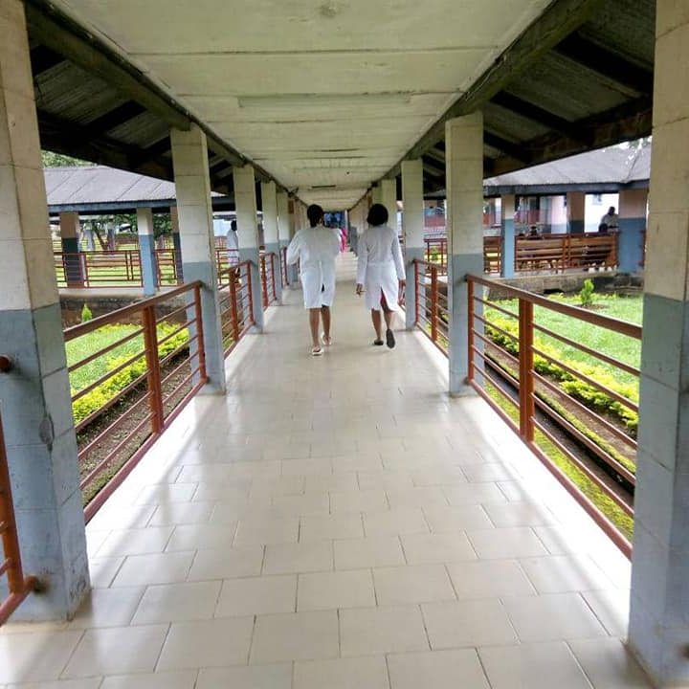
Study setting and population
Regional Hospital, located in the coastal town of Limbe in Southwest Cameroon
  Otherwise known as “Mile One Hospital”
Women living with HIV (WLWH) and not living with HIV (HIV[-])
  Aged > = 25
  Ever or currently sexually active
  Not pregnant at enrollment into the study
  Never screened for or diagnosed with cervical cancer
  Was able to provide both self-collected and provider-collected biological samples for HPV testing
  Was able to understand and sign the informed consent
Male spouses or partners of enrolled women were recruited

Slide 6
Study Design
Nested within the Central Africa International Epidemiology Database to Evaluate AIDS (CA-IeDEA) project in Cameroon⁴
Exploratory, descriptive qualitative approach
Two-stage purposive sampling strategy to systematically select the women and men for focus group discussions (FGD) and in-depth interviews (IDI)
Semi-structured interview guide informed by the socioecological framework⁵
 | FGD |  |  |  | IDI
 | 25-35 | 36-45 | >= 46 | Men
WLWH | 12 | 12 | 12 | 12 | 4
HIV[-] | 12 | 12 | 12 | 12 | 4

Slide 7
Data processing & Analysis
Daily reconciliation of notes among team in Cameroon
Labeling of audio recordings and field notes
Routine debriefings involving the team in the US
Translation
Verification
Identification of themes and development of an apriori codebook developed by the lead author
Three- stage iterative process of developing in the codebook

Slide 8
Table 1. Demographic characteristics of women in the study
Demographic Characteristics | %
Mean Age | 42.6
Marital Status
Single | 34.9
Married | 44.6
Other | 20.5
Education
None | 3.2
Primary | 11
Secondary | 52.8
Tertiary | 33
Employment
None | 40.6
Self Employed | 49.8
Government | 9.6
Income
None | 42.8
< 50,000 CFA | 38.4
> 50,000CFA | 18.8
Mean age at sex debut | 17.2
Lifetime sex partners
1 | 8.7
2–4 | 46
5–6 | 21
7–9 | 8.9
10 or more | 11.7
Don't Know | 3.7
Current oral contraceptive use | 33.9

Slide 9
MICRO-level (individual) FACTORS
 | Challenges | Opportunities
Awareness and knowledge | Older women were more likely to believe myths and misconceptions about cervical cancer | Nearly all women were aware of at least one type of cancer – cervical and breast cancer most commonly
Risk perceptions and health-seeking behaviors | Limited knowledge of the relationship of HPV and cervical cancer | Younger women were more likely to demonstrate knowledge of risk factors associated with each type of cancer
 | Varied perception of risk associated with age, HIV status, adherence to myths and misconceptions and perceived risk of cervical cancer | Nearly all women were aware of increased risk of cancer diagnosis in their community
 | All women had never been screened for cervical cancer | Younger women and those with higher education were more likely to take preventive actions to minimize their exposure to risk
 |  | Knowing someone diagnosed with cancer strongly influences perception of risk and willingness to initiative preventative behaviors
 |  | Those that were aware of the risks of cervical cancer were more likely to encourage others to take preventive measures against cervical cancer
Lack of access to information about cervical cancer screening services | Women did not have access to any source to obtain information about cervical cancer which made it possible for false and negative information about cervical cancer to spread in their communities | Women sought information about cervical cancer from internet sources or private health facilities offering screening and other services related to cervical cancer
Cost as a deterrent to cervical cancer screening | Absence of publicly funded cervical cancer screening programs | Available at a few private health facilities, but these services are expensive so many women cannot access them
 | Difficulties with personal finances due to high unemployment rates in the country places paying for cervical cancer prevention as low on the list of priorities | Women were likely to appear for cervical cancer screening if it was free and transportation costs were reimbursed
 | The cost of transportation to health facilities is an additional financial deterrent

Slide 10
Meso-level (Community Norms & Social Networks) FACTORS
 | Challenges | Opportunities
Social networks and social norms | The type of information about cervical cancer is determined by the amount of cervical cancer knowledge that community has and how much they are attached to myths and misconceptions about cervical cancer | Community education and stigma reduction around cervical cancer is likely to have a high impact because individual’s knowledge and behaviors are shaped by and conform to expectations is set by the level of awareness in their community
Cultural norms and the role of men | Men do not take much interest in women’s health issues or encourage preventative behaviors as a result of cultural expectations of how men should conduct themselves | Younger women are encouraging men to be proactive in taking concrete action to help prevent their spouses from getting cervical cancer (ie: not having multiple partners, encouraging their wives to participate in regular screening, etc.)
 | Men with negative attitudes about cervical cancer believe there is very little to be done to prevent cervical cancer | Men with higher levels of education demonstrated better knowledge of risk factors and was more likely to demonstrate a positive attitude to cervical cancer prevention
HIV and health-related social stigma | Ignorance and fear of death contribute to the stigma surrounding cervical cancer | Lots of opportunity for stigma reduction activities in communities
 | The belief that cervical cancer is untreatable fuels stigma
 | Disease associated with women’s reproductive organs contribute to stigma given cultural norms around female sexuality
Lack of cancer prevention policies | Rural–urban disparities in health care infrastructure and supplies | Interest from age-eligible women to be educated on cervical cancer prevention

Slide 11
Macro-level (structural: Health systems & Policy) FACTORS
 | Challenges | Opportunities
Weak health system and lack of infrastructure | Lack of cervical cancer screening facilities in the regional hospital requires travel to large urban centers for screening | Private clinics have made cervical cancer screening
 | Limited basic equipment for screening
 | Shortage of trained health care workers who can keep up with demand
 | Weak health care system and poor condition of physical health centers
 | Emphasis on HIV/AIDS within the health system leaving little space for competing health priorities
 | Shift to private facilities leading to higher costs for patients with limited trust in providers’ skills
Lack of cancer prevention policies | Lack of comprehensive policies that can aid awareness and encourage positive attitudes to cervical cancer screening
Cervical cancer screening in in the context of HIV/AIDS care and treatment program | Women not living with HIV or of unknown status did not want to seek screening from services integrated with HIV/AIDS care because of potential HIV-related stigma they may face | Integration of cervical cancer screening within HIV care and treatment programs
 |  | Interest in community-based cervical cancer screening programs which can be accessed in community settings or done in their own homes
Lack of cancer prevention policies | Limited commitment from government and politicians to improve population health | Interest from age-eligible women to be educated on cervical cancer prevention
 | Rural–urban disparities in health care infrastructure and supplies

Slide 12
Discussion
Cervical cancer prevention programs in SSA
Micro-level changes
Failure to reach benchmarks
Meso-level changes
Macro-level changes

Slide 13
Strengths & Limitations
Strengths
Limitations
Knowledge of the socio-contextual barriers to women’s access cervical cancer screening and care in a high HIV prevalence, low-income contexts
Elements of the study design may impact the extent to which results are generalizable to women in dissimilar settings:
  the qualitative nature of the data
  the participants selected
  the setting of the study within the context of a larger ongoing clinical-based study

Slide 14
Conclusion
The importance of the individual, familial, community and structural factors
These issues should be considered to increase access to cervical cancer screening
Our results highlight gaps in the uptake of cervical cancer screening programs, which must be addressed

Slide 15
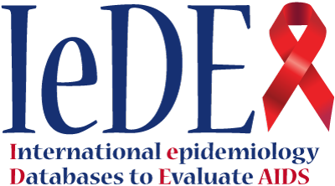
References
World Health Organization. Cervical cancer. Available at: https://www.who.int/cancer/prevention/diagnosis-screening/cervicalcancer/en/
Global Cancer Observatory. Cameroon Cancer Statistics. Available at: http://gco.iarc.fr/today/data/factsheets/populations/120-cameroon-fact-sheets.pdf
Donatus L, Nina FK, Sama DJ, et al. Assessing the uptake of cervical cancer screening among women aged 25–65 years in Kumbo West Health District Cameroon. Pan Afr Med J. 2019;33:106. https://doi.org/10.11604/pamj.2019.33.106.16975.
The International Epidemiology Databases to Evaluate AIDS. Available at: https://www.iedea.org/
Kristin AR, Judith KO, Lori P. The Handbook of Health Behavior Change, 4th Edition, (2013). Springer Publishing Company.
Black E, Richmond R. Prevention of cervical cancer in Sub-Saharan Africa: the advantages and challenges of HPV vaccination. Vaccines (Basel);6(3):61. https://doi.org/10.3390/vaccines6030061
Rahman R, Clark MD, Collins Z, Traore F, Dioukhane EM, Thiam H, Ndiaye Y, De Jesus EL, Danfakha N, Peters KE, Komarek T, Linn AM, Linn PE, Wallner KE, Charles M, Hasnain M, Peterson CE, Dykens JA. Cervical cancer screening decentralized policy adaptation: an African rural-context-specific systematic literature review, Global Health Action, 2019. Vol 12:1, 1587894, https://doi.org/10.1080/16549716.2019.1587894
Delany-Moretlwe S, Kelley KF, James S, et al. Human papillomavirus vaccine introduction in South Africa: implementation lessons from an evaluation of the National School-Based Vaccination Campaign. Glob Health Sci Pract. 2018;6(3):425–38. https://doi.org/10.9745/GHSP-D-18-00090.
Nkfusai NC, Cumber SN, Anchang-Kimbi JK, Nji KE, Shirinde J, Anong ND. Assessment of the current state of knowledge and risk factors of cervical cancer among women in the Buea Health District Cameroon. Pan Afr Med J. 2019;33:38. https://doi.org/10.11604/pamj.2019.33.38.16767.
Gatumo M, Gacheri S, Sayed AR, Scheibe A. Women’s knowledge and attitudes related to cervical cancer and cervical cancer screening in Isiolo and Tharaka Nithi counties, Kenya: a cross-sectional study. BMC Cancer. 2018;18(1):745. https://doi.org/10.1186/s12885-018-4642-9.
Shiferaw S, Addissie A, Gizaw M, et al. Knowledge about cervical cancer and barriers toward cervical cancer screening among HIV-positive women attending public health centers in Addis Ababa city. Ethiopia Cancer Med. 2018;7(3):903–12. https://doi.org/10.1002/cam4.1334.
Musa J, Achenbach CJ, O'Dwyer LC, et al. Effect of cervical cancer education and provider recommendation for screening on screening rates: A systematic review and meta-analysis [published correction appears in PLoS One. 2017 Dec 29;12 (12 ):e0190661]. PLoS One. 2017;12(9):e0183924. Published 2017 Sep 5. https://doi.org/10.1371/journal.pone.0183924
Bingham A, Bishop A, Coffey P, Winkler J, Bradley J, Dzuba I, Agurto I. Factors affecting utilization of cervical cancer prevention services in low-resource settings. Salud Publica Mex. 2003;45(Suppl 3):S408–16.
Devarapalli P, Labani S, Nagarjuna N, Panchal P, Asthana S. Barriers affecting uptake of cervical cancer screening in low and middle income countries: A systematic review. Indian J Cancer . 2018;55(4):318-26. https://doi.org/10.4103/ijc.IJC_253_18.

Slide 16
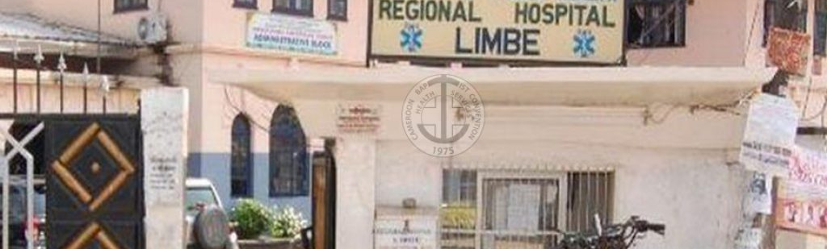
Questions?

